Slide 1


InMobi
Strategy Evaluation
in the Digital Experience Era
A Strategic Business Analysis of InMobi Group
2023 – 2025
2B+
450M+
200+
Mobile Users
Devices
Countries
Presented By:
Ancilla Fiona Dsouza
Notes:
1

Slide 2
Introduction to InMobi Group
Disrupting the Traditional Funnel: From Mobile-First to Experience-First
01
The Infrastructure Engine
02
The Discovery Layer
03
Content & Commerce Ecosystem
B2B
B2C & OEM Integrated
Nostra & Roposo
InMobi Advertising: A global programmatic advertising and monetization powerhouse connecting brands to over 2 billion active mobile users on the open web. Driven by advanced analytics, predictive intelligence, and cookie-less identity resolution.
Glance Smart Lock Screen: Backed by Google and Jio Platforms, pre-integrated with major smartphone OEMs. Operates directly on the device's 'Surface Zero' (the lock screen) across 450+ million devices globally.
Nostra: India & Southeast Asia's largest lock-screen gaming platform. Roposo: drives the creator-led economy through immersive 'Hyperlive' streaming and instant AI-driven digital commerce.
Notes:
2

Slide 3
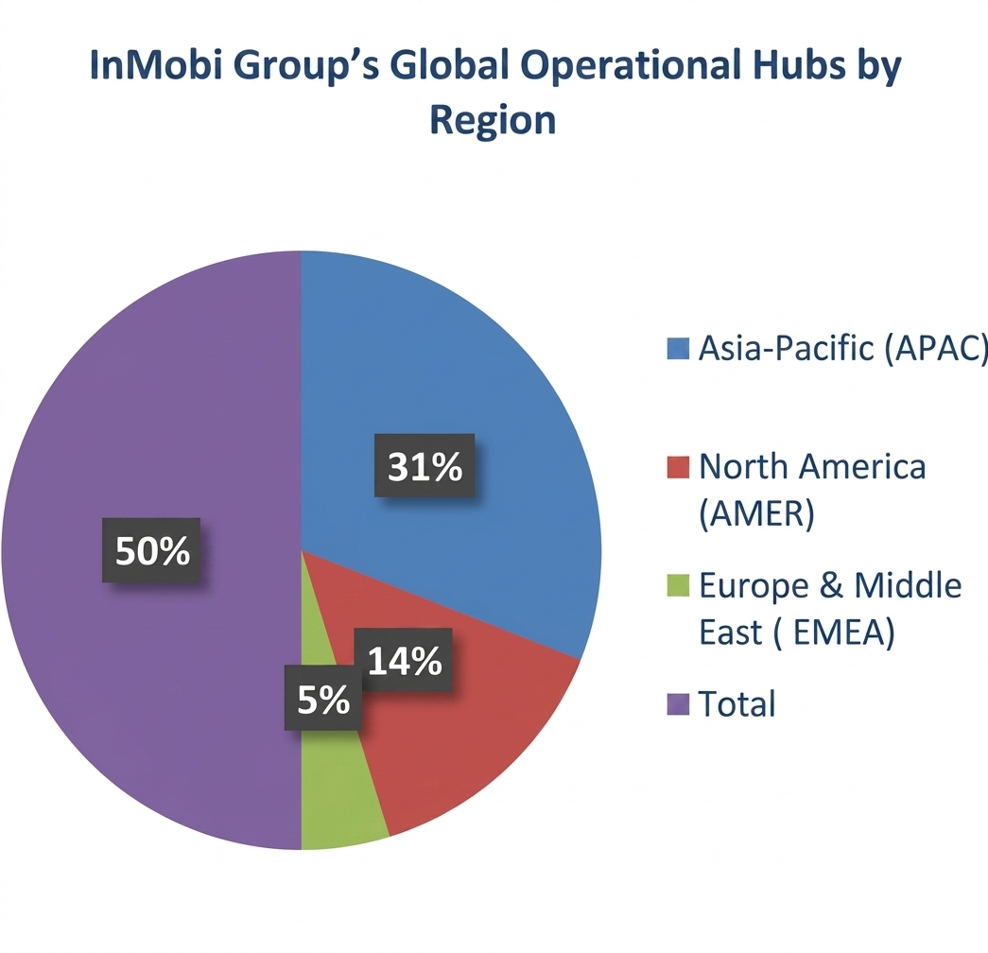
Company Overview: InMobi Group
A global leader making mobile and lock screen experiences simple and instant.
Who is InMobi?
InMobi is a leading global technology company building smart tools for mobile marketing, advertising, and content discovery — connecting brands and publishers to 2B+ mobile users worldwide. HQ in Singapore with major offices in Bangalore and San Mateo.
Reimagining the Mobile Journey
InMobi owns Glance (world's leading smart lock screen), Nostra (gaming), and Roposo (live streaming). These platforms help consumers find shopping, news, and games instantly — without searching or downloading apps.
Privacy, Trust & Global Funding
Operating directly on a phone's main screen, InMobi ensures all content is 100% safe and privacy-first. It partners with premium media companies for trusted content. Funded by global giants including Google and Jio Platforms.
Notes:
3

Slide 4
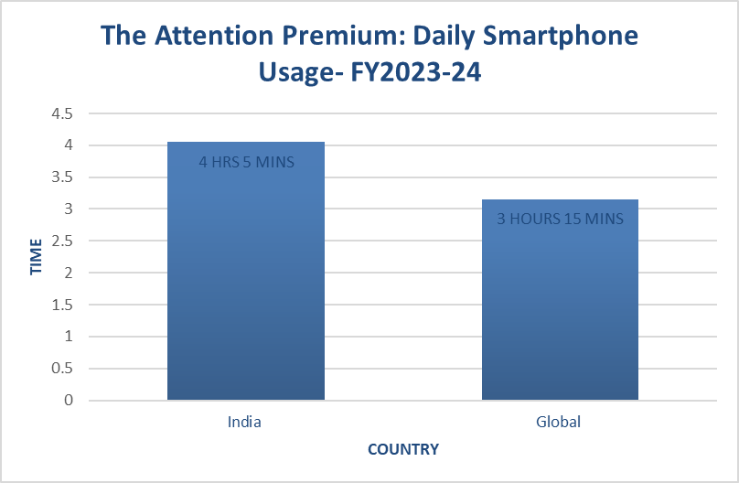
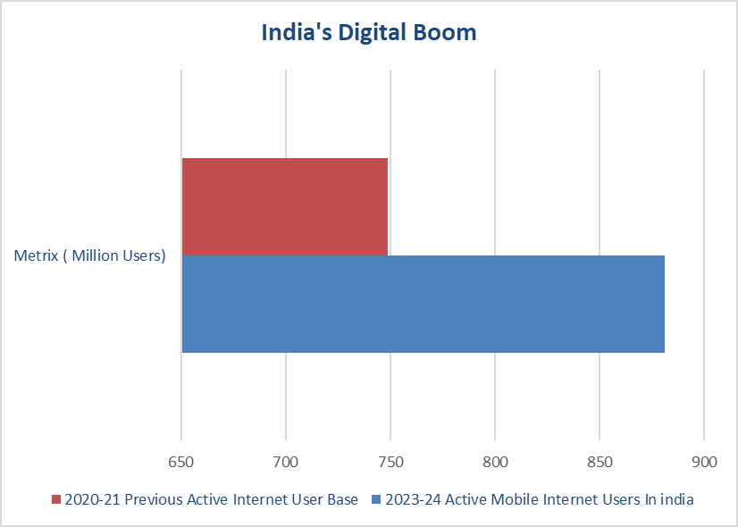
India's Fast-Growing Digital Market
How more internet users and shorter attention spans are changing mobile marketing.
881M
71%
$1T
8.25s
Internet Users in India
Smartphone Penetration
Internet Economy by 2030
Human Attention Span Today
Notes:
4

Slide 5
Business Model of InMobi Group
How InMobi creates value and drives revenue through B2B and B2C ecosystems.
The B2B Engine
The B2C Layer
Ecosystem & Partner Revenue
InMobi Advertising
Glance & Roposo
OEM & Media Partnerships
What it does:
What it does:
What it does:
Enterprise tech providing data-driven media solutions.
Consumer tech by InMobi's subsidiary Glance — backed by Google & Jio.
Premium ecosystem through official partnerships — no random user-generated posts.
Value Creation:
Value Creation:
Connects global advertisers & publishers with 2B+ target mobile audiences on the open web.
Runs on mobile lock screen 'Surface Zero', serving instant news, games & live streaming.
Value Creation:
Integrates directly with Samsung, Xiaomi, Vivo via OEM pre-installs.
Advanced analytics for impactful ad campaigns.
Eliminates the traditional multi-step app journey.
Partners with trusted media houses for safe, professional content.
Monetization tools for independent app developers.
Captures user attention at the first screen interaction.
Premium advertisers pay a premium for trusted lock-screen real estate.
Notes:
5

Slide 6
Product, Service & Technology
Moving from traditional search apps to instant, AI-driven lock screen experiences.
Glance – The Smart Lock Screen Platform
InMobi Advertising & Glance AI
B2C Product
A built-in phone feature that transforms the mobile standby screen into a live discovery page. Removes the need to unlock, search online, or download dozens of apps — with just a single tap, users instantly view bite-sized news, live events, sports, and wallpapers.
The Technology Engine
Advanced Ad Targeting
Global brands get data-driven advertising tools with predictive intelligence. Highly relevant, full-screen ads delivered to right users on the open internet — without violating user privacy.
Nostra & Roposo – Gaming & Live Video
Services
Glance AI Architecture
Nostra (Gaming): Largest lock screen gaming platform in India & SEA. Instant, high-quality games — no installation needed.
Roposo (Live Commerce): Live streaming platform powering a new creator economy. Hosts interactive streams, product reviews, and real-time instant shopping.
Proprietary AI combining smart machine learning and real-time visualization. Studies user habits to automatically predict what content, game, or product a user wants to see — before they even search.
Product definitions sourced from InMobi Mobile Marketing Handbooks (2023–2025).
Notes:
6

Slide 7
Data Analysis & Consumer Insights
Decoding user preferences, festive traffic spikes, and mobile shopping habits in India.
Consumer Content Affinity Analysis
21%
17%
12%
01
On-device tracking shows Indian users prefer visual, bite-sized updates. Lock-screen discovery traffic dominated by National News (21%), Sports (17%), and Entertainment (12%). Single-tap live updates outperform traditional app or web browsing.
National News
Sports
Entertainment
Festive Ad Interaction & Traffic Surge
+204%
+202%
+106%
02
Lock-screen ad campaigns during Diwali & festive seasons show massive conversion boosts vs. standard apps. Brands reaching consumers at 'screen-light' moment drive immediate purchasing action.
Quick-Commerce
E-Commerce
OTT Streaming
The Connected Shopper Mindset (2025)
85%
83%
80%
03
Indian shoppers are highly connected and expect interactive, intelligent experiences. 4 in 5 shoppers actively seek AI-driven product recommendations that predict wants without requiring search.
Shopping = Top Activity
Online While In-Store
Expect AI Recs
Notes:
7

Slide 8
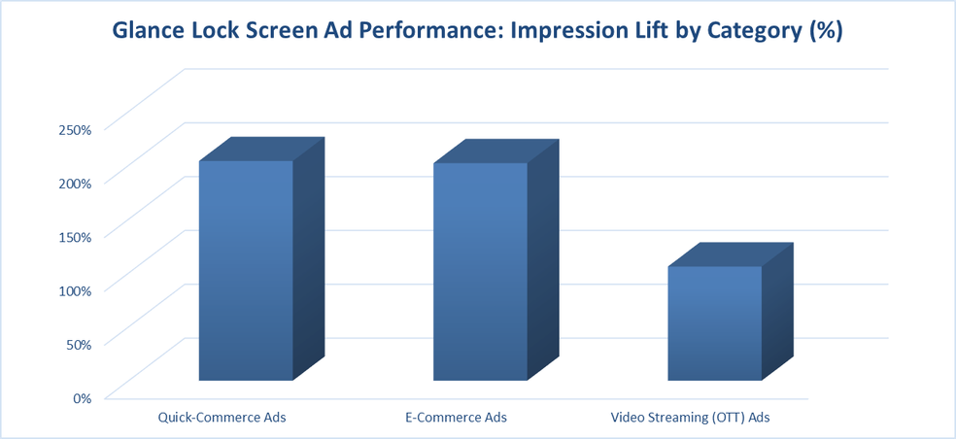
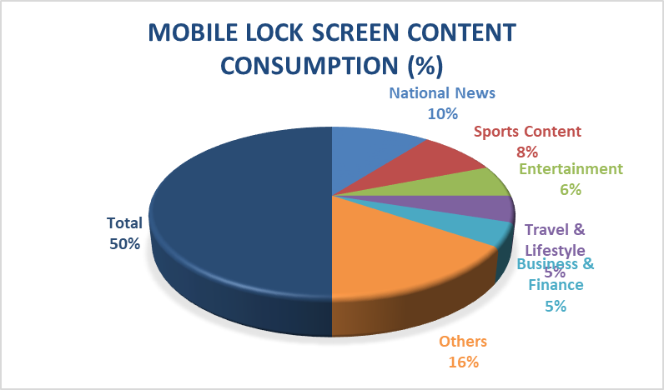
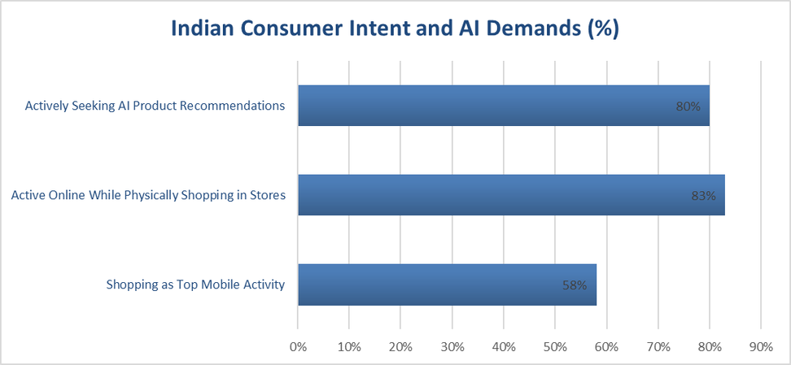
Data Visualizations
Lock screen engagement, festive ad lift, and AI shopper trends — all in one view.
Notes:
8

Slide 9
Success Factors & Business Challenges
What Makes InMobi Win and What It Must Avoid.
WHY INMOBI SUCCEEDS
Daily Business Challenges
Built Into the Phone
The Goldfish Problem
App Download Fatigue
Too Many Bad Ads
Partners directly with Samsung, Xiaomi & top OEMs. Glance pre-installed before a user ever unlocks their device.
Human attention spans have dropped to 8.25 seconds. Content must catch the eye instantly.
Users are tired of multiple apps. They want everything in one tap.
Traditional pop-up ads annoy users. Brands must switch to fun, interactive content.
Smart AI Feed
Glance AI studies user preferences and automatically surfaces the right content, game, or product instantly.
Privacy & Content Risks
All-in-One Network
New Privacy Laws
Keeping Content Safe
Lock Screen Crowding
Seamlessly connects business ads, lock screen news, and live shopping into one unified ecosystem.
Old user-tracking methods are being blocked. InMobi must find privacy-safe ad delivery.
Lock screen must only serve safe, trusted news from premium partners — never random posts.
Too many automated suggestions can annoy users who just want a quick glance at their phone.
Notes:
9

Slide 10
Conclusion & Next Steps
How Brands Can Win the Attention of Modern Shoppers.
The Future Outlook: Mobile marketing has fundamentally changed. It is no longer about being on a phone — it is about delivering a great experience instantly. The future belongs to smart systems that show users exactly what they want the very second their phone screen lights up.
Three Main Recommendations
Simple Steps to Follow
Stop the 8-Step Journey
Use the Lock Screen — stop spending only on traditional apps; put your brand on standby screens.
Make Interactive Ads — replace flat banners with full-screen videos and playable games.
Brands must stop making users click through 8-step paths to buy something.
Add AI Shopping Tools — virtual try-ons and auto-recs help shoppers choose faster.
Target Whole Families — run household-level campaigns, not just individual targeting.
Build single-tap, instant-access experiences on the lock screen.
Be Everywhere — 92% of festive shoppers buy more when they see a brand across multiple screens.
Keep it Clean & Beautiful — use premium visuals and trusted creators for safe, professional brand presence.
Leverage Glance AI to predict and serve relevant content before users even search for it.
Notes:
10

